Slide 1


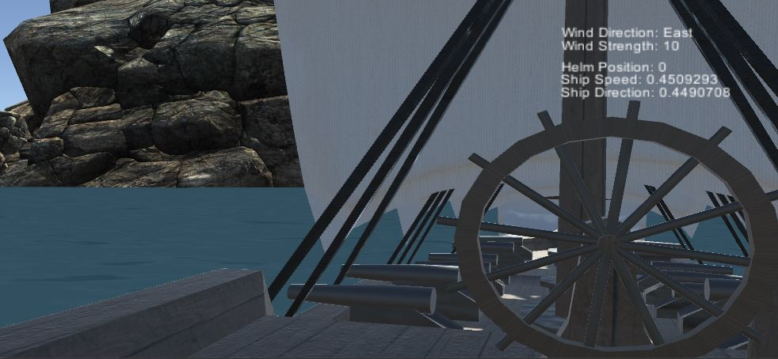
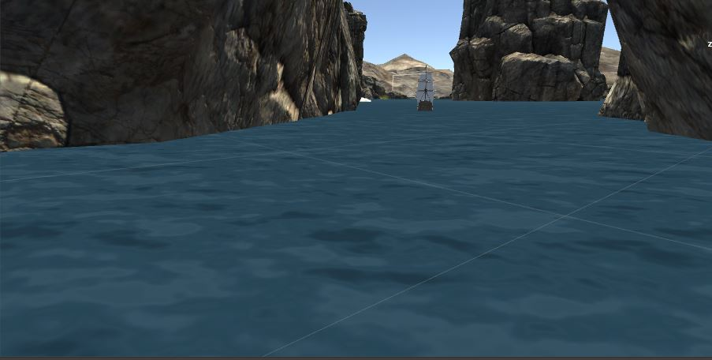
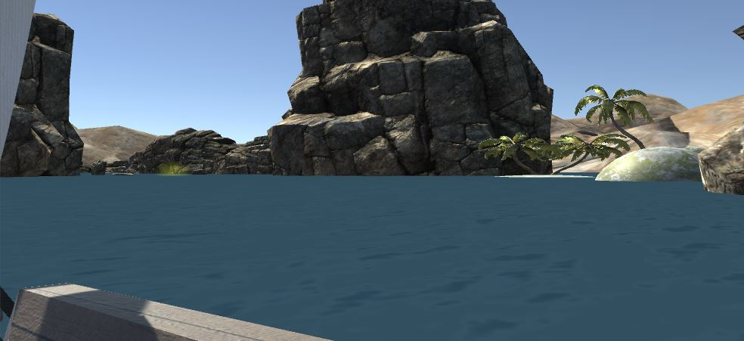
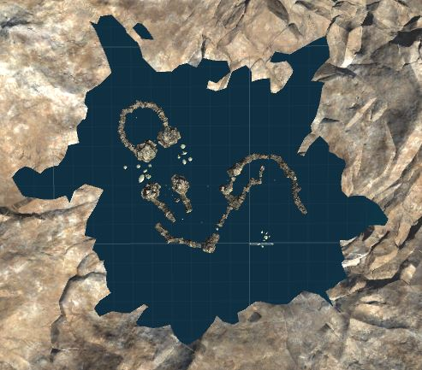
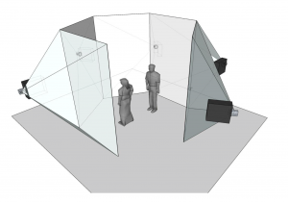





Sailing in the ICave
TAM: Learning with Virtual Reality
VIP, Spring, 2017
Student: Noel Gonzalez, Florida International University
Mentor: Francisco Ortega , Florida International University
Instructor: Masoud Sadjadi , Florida International University
Introduction and Problem Statement
z
The ICave is a next generation virtual reality system still under development. It is on a whole other level compared to other virtual reality equipment, being a full almost 360 degree surround room system that displays the entire view in real time. In order to take advantage of these features, we had to create a full 3D game with some kind of exploration feature rather than a small confined area. We then had to turn this large 3D environment into a learning environment.
Solution
Current System
The first solution was a virtual 3D coding environment using virtual blocks as blocks of code. However, that solution was rejected because it does not work very well in a full 3D environment that is the ICave. The current solution is a sailing program that teaches how to sail and navigate through an interactive environment.
In the current iteration of the system we have a basic setup where the player sails the ship over “treasure chests” while avoiding cliffs, rocks, and tiny islands. If the player hits any of the aforementioned objects, the ship crashes and begins to sink forcing the player to start all over. Currently, movement is based on the environment, namely the wind strength, direction, and the direction of the ship itself.
The scene from the player’s perspective (with UI).
Third person perspective of the scene.
First person perspective of the scene (without UI).
Top-down view of the scene. In the current system, the player begins in the enclosed area and must first navigate out of it to progress. The player then is tasked with the wayfinding aspect of the project after leaving this area. From that point on, it is up to them to locate and collect the items.
A model of the ICave’s hexagonal display structure. Users wearing the ICave 3D glasses see a continuous 3D screen.
Requirements and Development
Verification
Implementation
Create a basic environment for the player to move and sail on. This includes the actual ship and surrounding water. Status: DONE
Create a realistic movement system for the ship. Status: DONE
Upgrade the movement system to rely on the environment for speed values, increasing realism. Status: DONE
Create a sophisticated scene for the player to sail in. Status: NEEDS OPTIMIZATION
Create a basic UI that displays information
Status: DONE
Create an advanced UI that handles toggling between ship controls and player controls. Status: TO DO
Create items players must pickup while sailing. Status: DONE
Handle collisions between the player’s ship and static objects. Status: DONE
Enhance the ship’s realism further by adding sail controls. Status: TO DO
Add AI ships with their own navigation and collision avoidance. Status: TO DO
Known Issues: Players can sometimes get out of the ship.; it seems to be a problem with the mesh collider. Some parts of the map suffer huge frame rate drops and need optimization. UI does not work sometimes in the ICave version of the game. There are also some bugs with the controls.
Purpose: Move around on the ship with the player object.
Inputs: Starting point, command to new point in line of sight.
Expected Result: Player moves to new point.
Actual Result: Player moved to the new point.
Test Result: Pass
Purpose: Move the ship with the ship controls (basic).
Inputs: Starting point, 10 seconds of time, command to hold down left turn for 4 seconds.
Expected Result: Ship’s position should be equivalent to the theoretical position.
Actual Result: Ship is in the theoretical position based on commands given.
Test Result: Pass
Purpose: Move the ship with the ship controls (advanced)
Inputs: Starting point, 15 seconds of time, command to hold down left turn for 6 seconds, wind strength of 1, wind direction of 0.
Expected Result: Ship’s position should be equivalent to the theoretical position.
Actual Result: Ship is in the theoretical position based on commands given.
Test Result: Pass
Purpose: Pickup items when sailing over them.
Inputs: Path of ship, item location
Expected Result: Item should disappear.
Actual Result: Item disappears.
Test Result: Pass
Purpose: Ship to stop moving and sink after a collision.
Preconditions: Ship is in a collision course.
Inputs: position of static objects
Expected Result: Ship should stop moving and begin sinking after colliding
Actual Result: Ship stops moving and begins sinking after a collision.
Test Result: Pass
Summary
Sailing in the ICave features a semi realistic sailing experience that teaches players the basics of sailing, navigation, and wayfinding in a full 3D environment developed for the ICave system. The main features include:
Sailing a sail ship with realistic turning and propulsion.
Active environment that actively affects the ship’s ability to move and rotate.
Challenging, scenic map that tests player wayfinding and navigation skills.
Scattered “treasure chest” objects that players must sail over to collect. These objects are found pseudorandomly throughout the map and force the player to explore, find, and then navigate to them to pick them up.
The material presented in this poster is based upon the work supported by Francisco Ortega, Unity, and the ICave development team. Special thanks to my teammate Michael Quiros for his contributions and Masoud Sadjadi for feedback.

